Slide 1

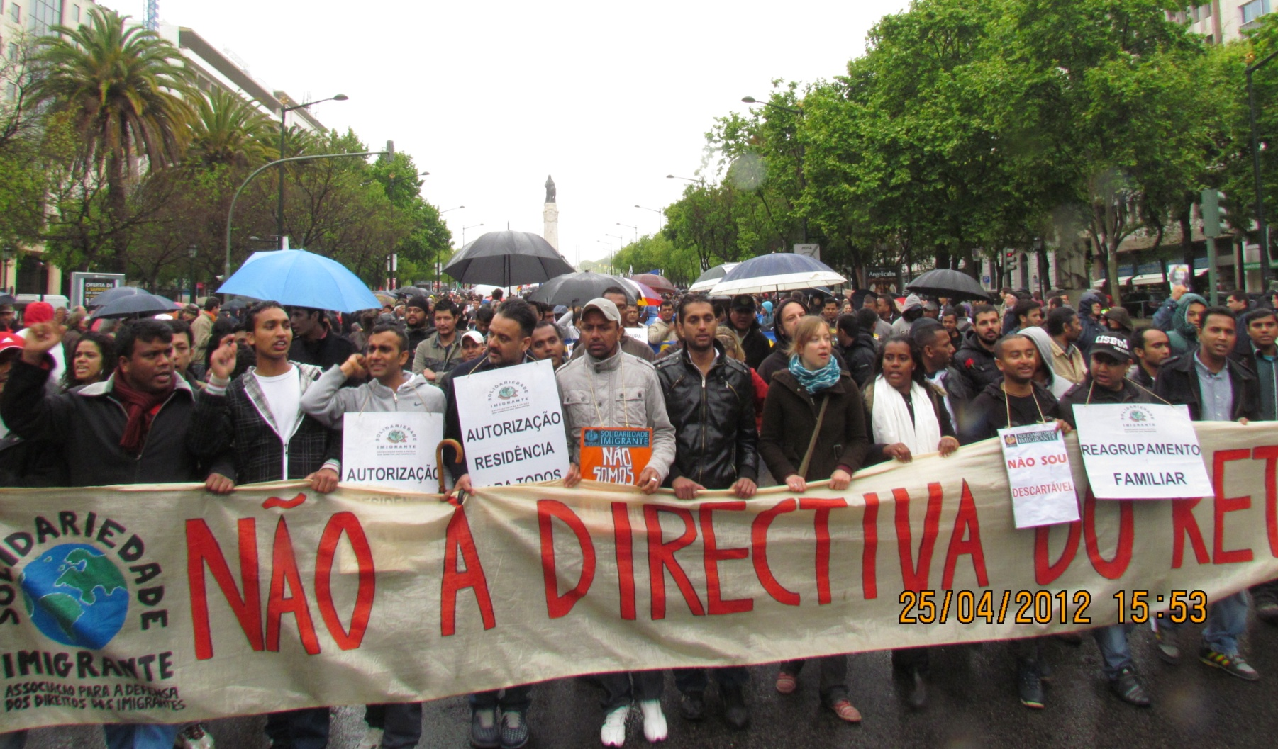
IMMIGRANT SOLIDARITY Association for the Defense of Immigrants' Rights

Slide 2
ABOUT US
Non-profit nationwide immigrants association founded in 2001.
Currently with over 22.000 members from 96 different countries.
Recognized by the High Commission for Immigration and Intercultural Dialogue (ACIDI).
Member of the Consultative Council for Immigration Affairs (COCAI).

Slide 3
ABOUT US
Headquarters in Lisbon and a network of four delegations: two in the Lisbon region and other two in the South of Portugal.
Member of various national and international organizations networks: Platform of Immigrant Associations, Combating Poverty and Social Exclusion Network, No-Vox Network.
Member of the Portuguese Social Forum.

Slide 4
OBJECTIVES
sede em Lisboa
Defending the immigrants’ rights through their empowerment and the promotion of a demanding citizenship.
Raising awareness in a perspective of human rights, equality of opportunities and social justice.
Fighting racism and xenophobia.

Slide 5
OBJECTIVES
Supporting everyone to exercise their rights as citizens, without regard to country of origin, religion, race or gender.
Promoting the knowledge, among the Portuguese society, of the reality of immigration in Portugal.

Slide 6
OBJECTIVES
Promoting the social and labor insertion of immigrants’ and their descendants.
Cultivating the solidarity between Portuguese and foreign citizens, in order to defend common interests to all workers.
Promoting interculturality and diversity.

Slide 7

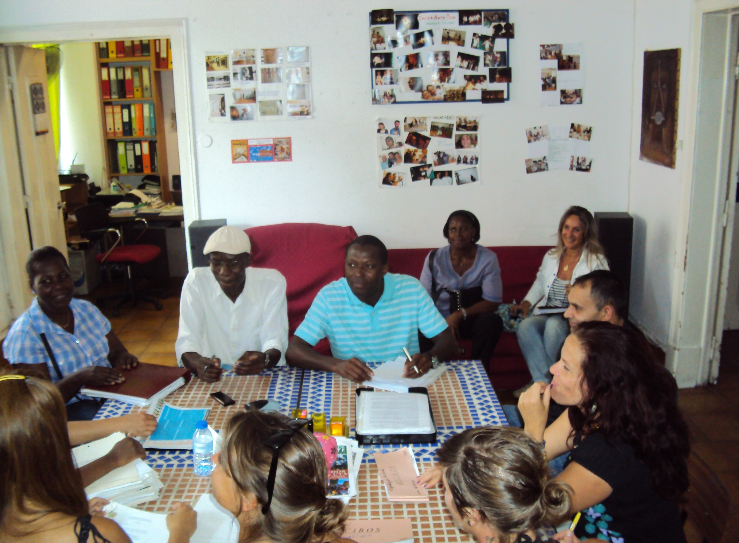

Slide 8
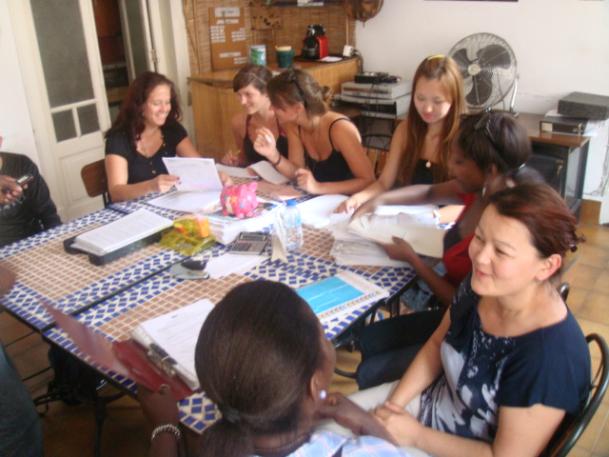

Slide 9
WHAT WE DO
Give information and legal support concerning regularizations (residence permit), family reunion, political asylum and right to education, health, social security and labor.
Help and accompany workers in the resolution of their problems at work.
Provide help in situations relating to prisons and the international area of the Lisbon airport.

Slide 10
WHAT WE DO
Present complaints to the Ombudsman when the immigrants’ rights are trampled.
Organize language courses (Portuguese, English, Russian, German and Arabic) and computer courses.
Organize dance, percussion, video and other artistic workshops

Slide 11



OUR NEWSPAPER

Slide 12

“RIGHT TO HOUSING” GROUP (D.A.H.)

Slide 13
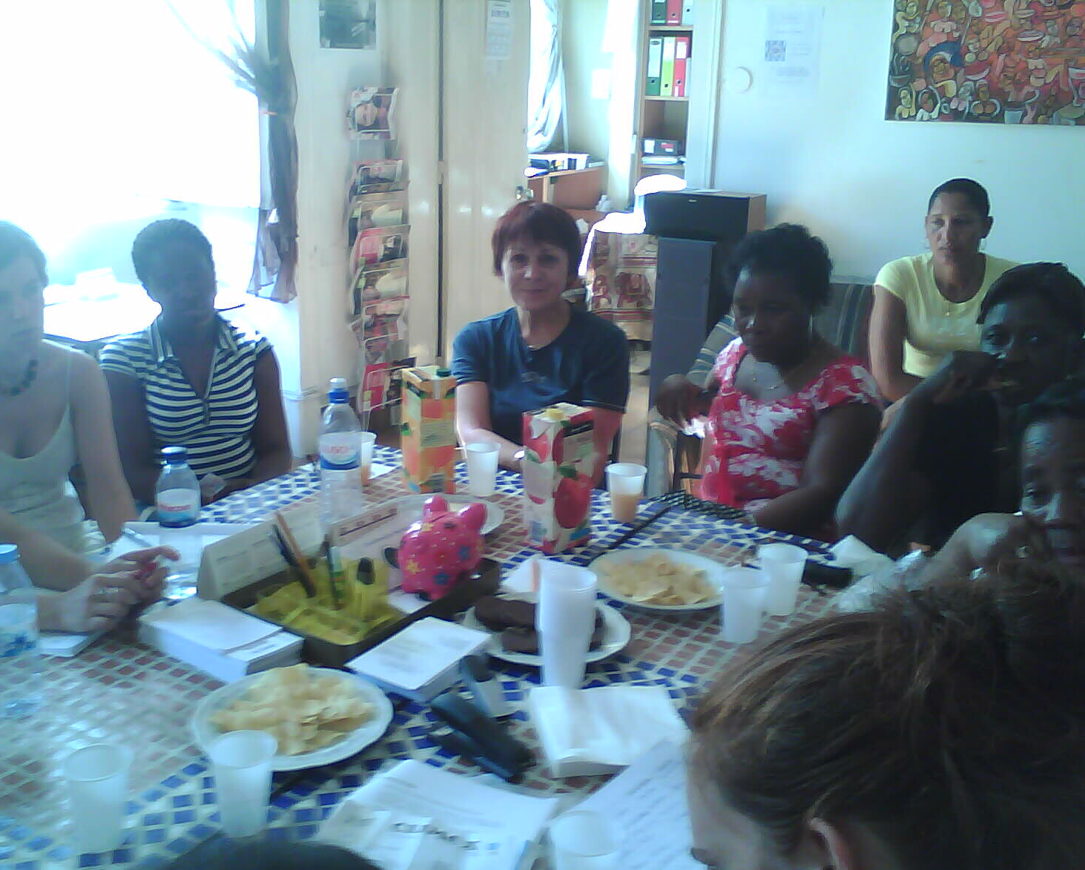
SUPPORT GROUP FOR IMMIGRANT WOMAN

Slide 14
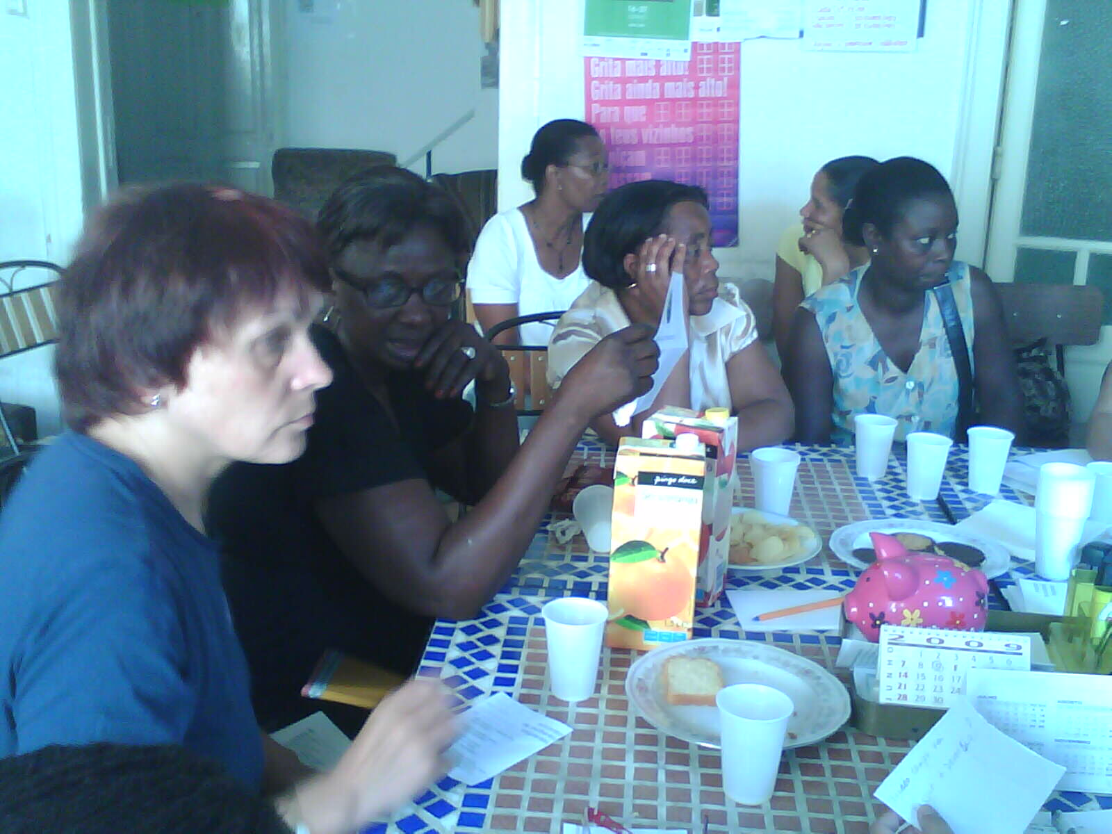
MEETINGS
Notes:
Promovemos encontros informais entre as mulheres imigrantes.

Slide 15


BROCHURE "RIGHTS AND OBLIGATIONS IN DOMESTIC WORK”
”
Notes:
Da parceria inovadora entre a nossa associação, uma associação feminista (UMAR) e academia (através de uma equipa de investigadores de um Centro de Estudos Socioeconómicos), editamos a brochura, que é não só um instrumento de informação para as trabalhadoras domésticas, mas também uma ferramenta poderosa na reivendicação dos seus direitos.

Slide 16
INTERCULTURALITY AND CITIZENSHIP
Debates an expositions about the fight of the immigrants in Portugal, in cooperation with universities, schools and other organizations.
Intercultural meetings and concerts in order to defense the human rights with the aim to give access to different cultures and to debate ideas and experiences (Festival ImigrArte)
Dinners with gastronomy of the world, accompanied with debates, movies and music from the various countries to promote the intercultural coexistence.

Slide 17
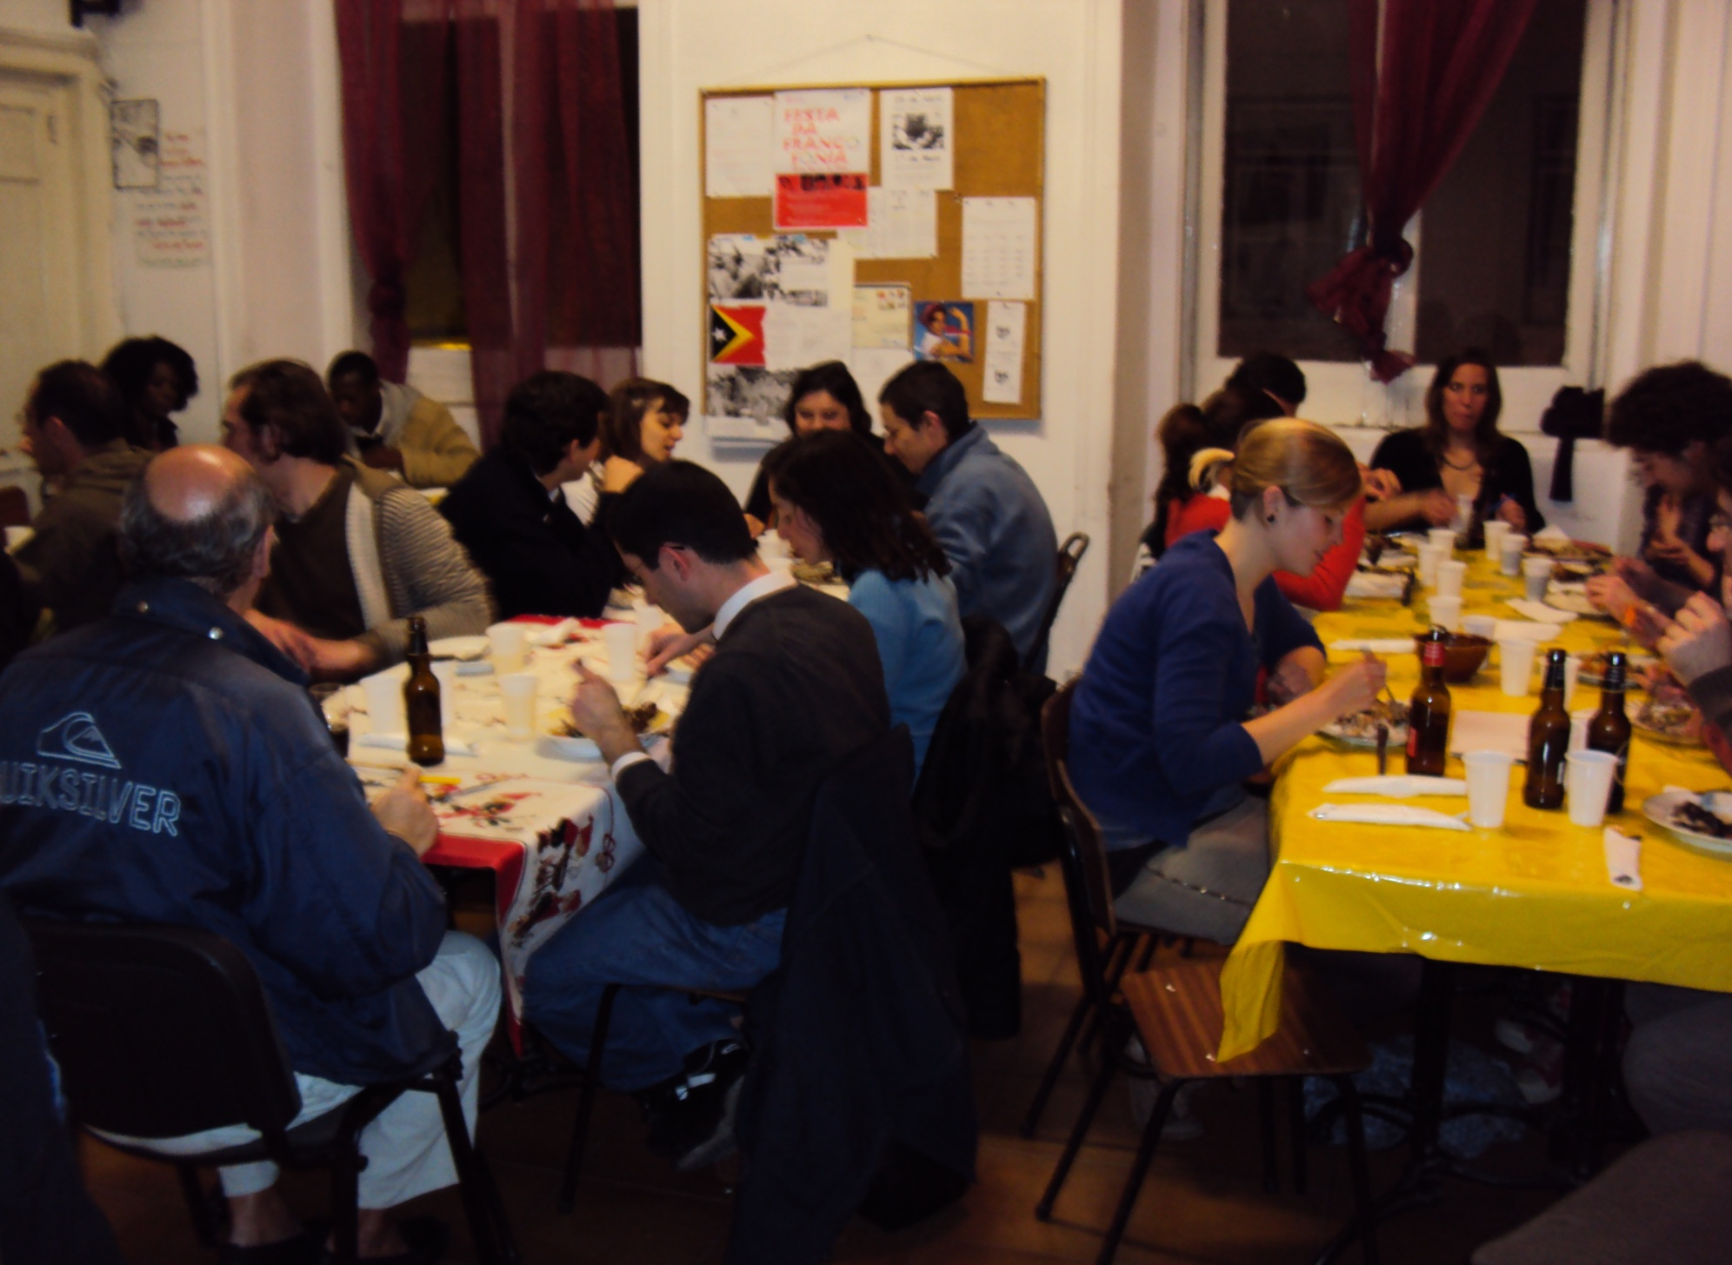

Slide 18
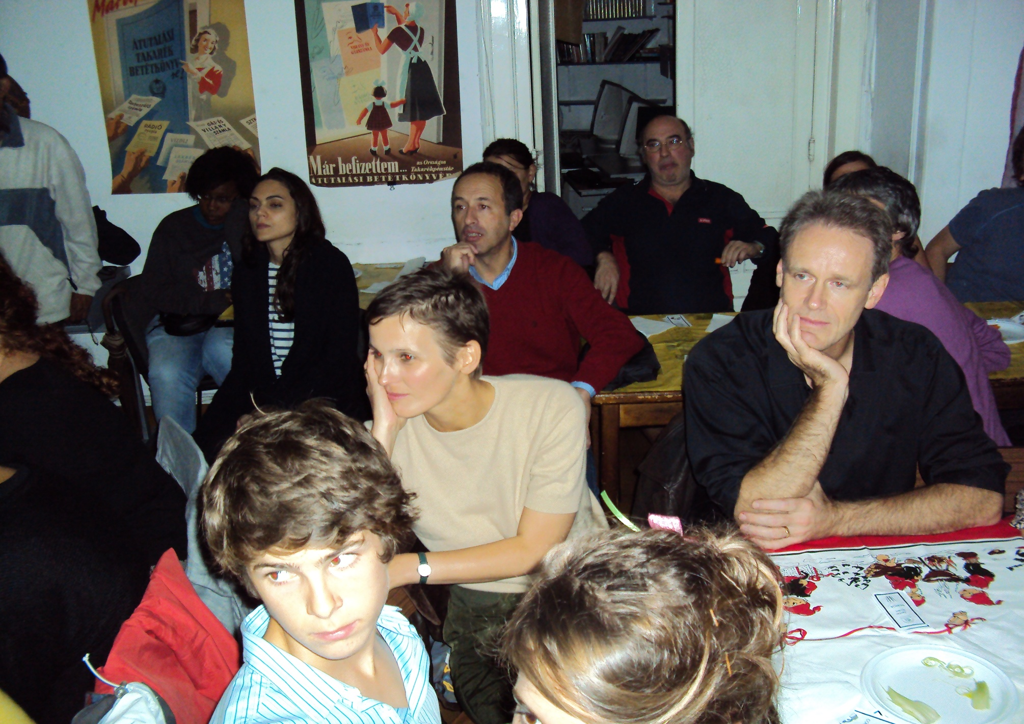

Slide 19
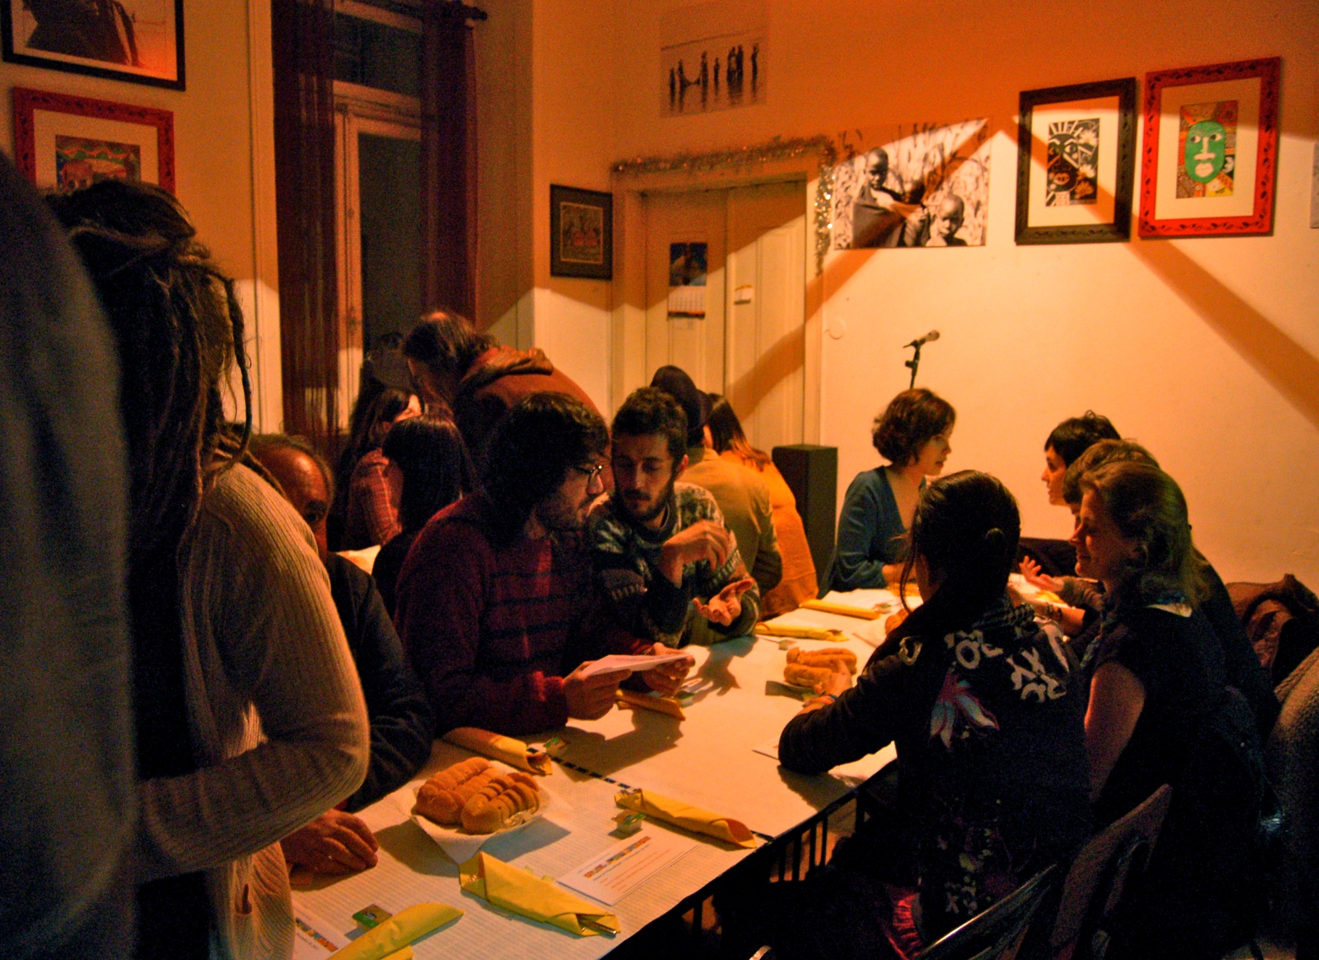

Slide 20
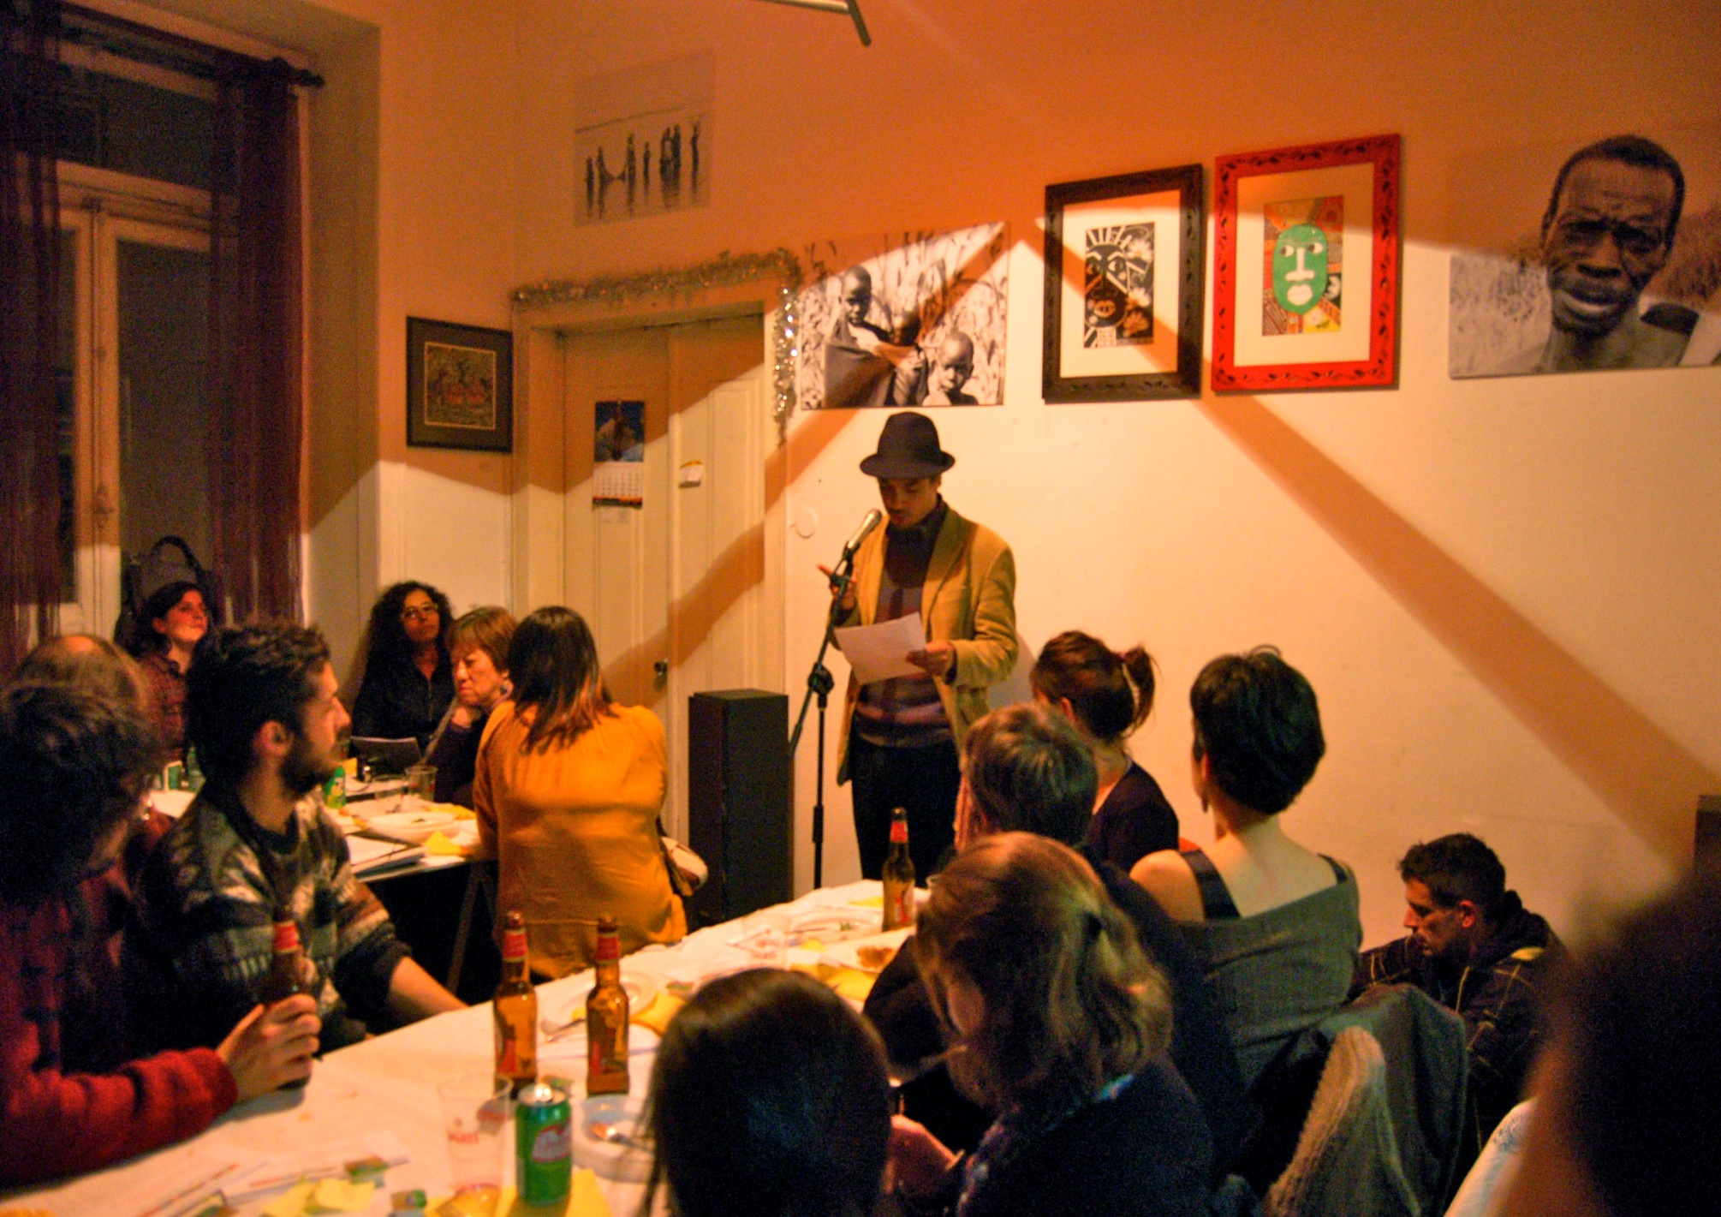

Slide 21
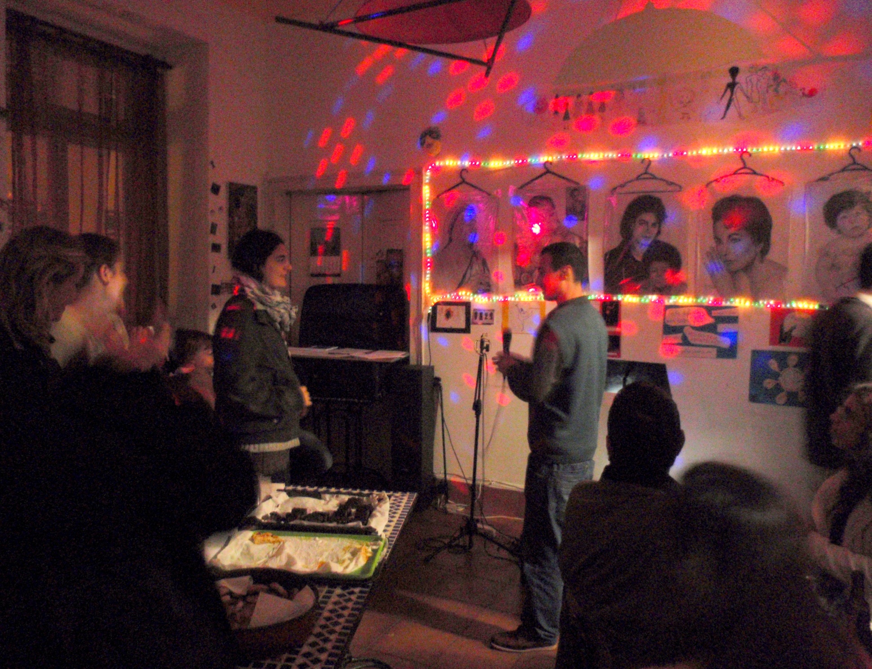

Slide 22
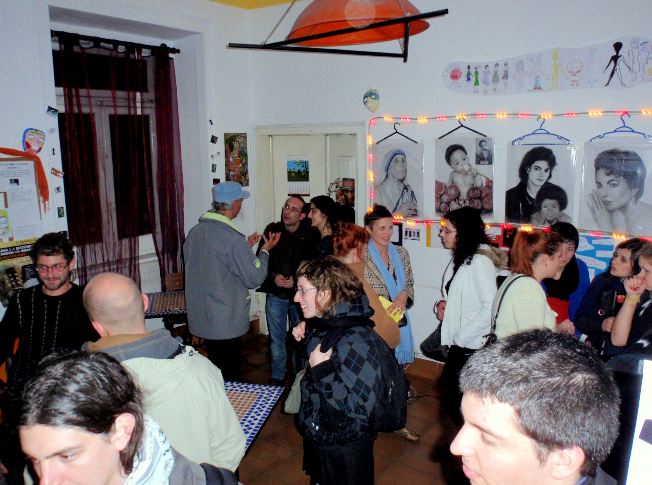

Slide 23
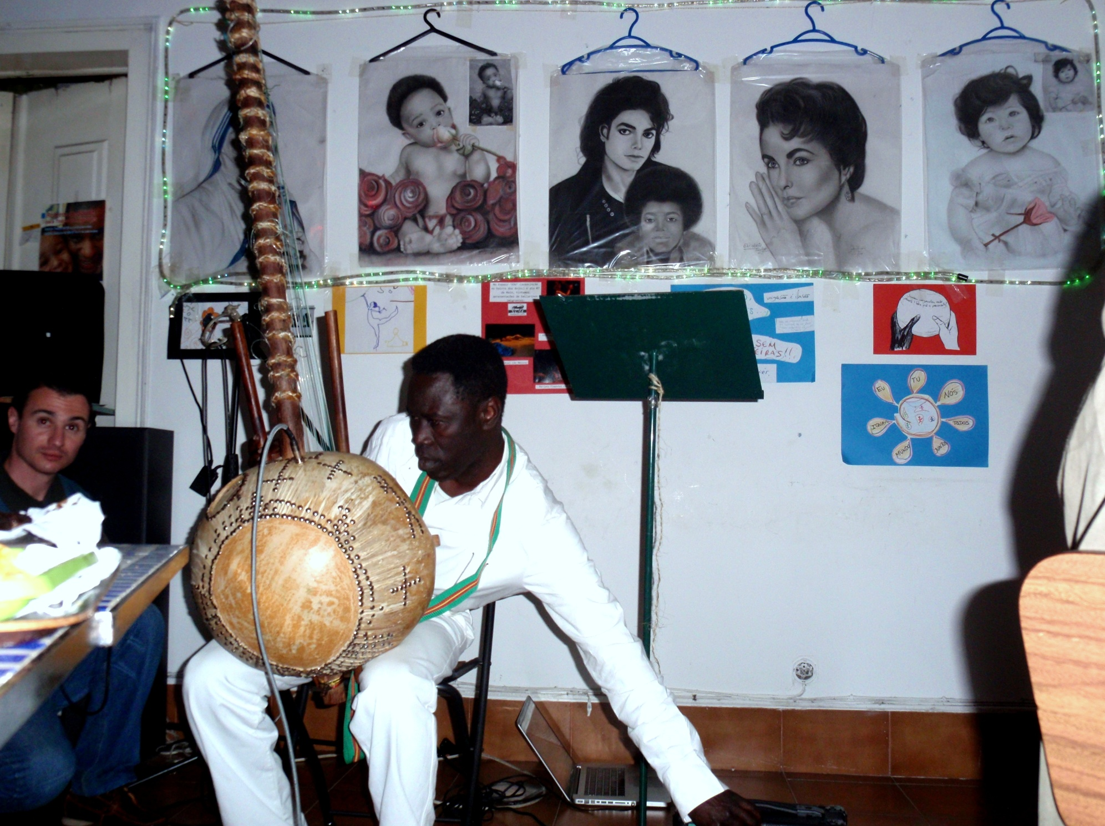

Slide 24
PARTNERSHIPS
With the Institute of Work and Professional Education (IEFP) - UNIVA, GIP
With Ministry of the Interior (Foreigners and Borders Service - SEF) – Intercultural Mediators
With High Commission for Immigration and Intercultural Dialogue (ACIDI) – Intercultural Mediators in National Supporting Center for Immigrants (CNAI).

Slide 25



OUR STRUGGLES, OUR CLAIMS

Slide 26
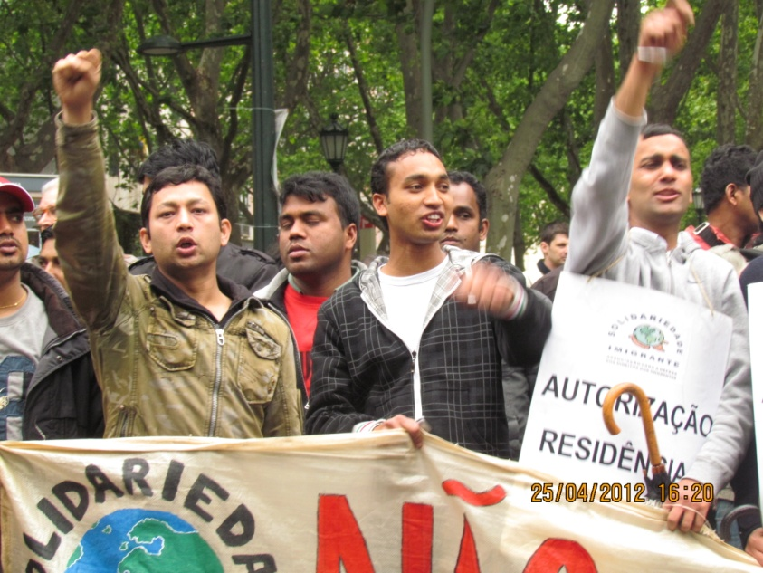

Slide 27
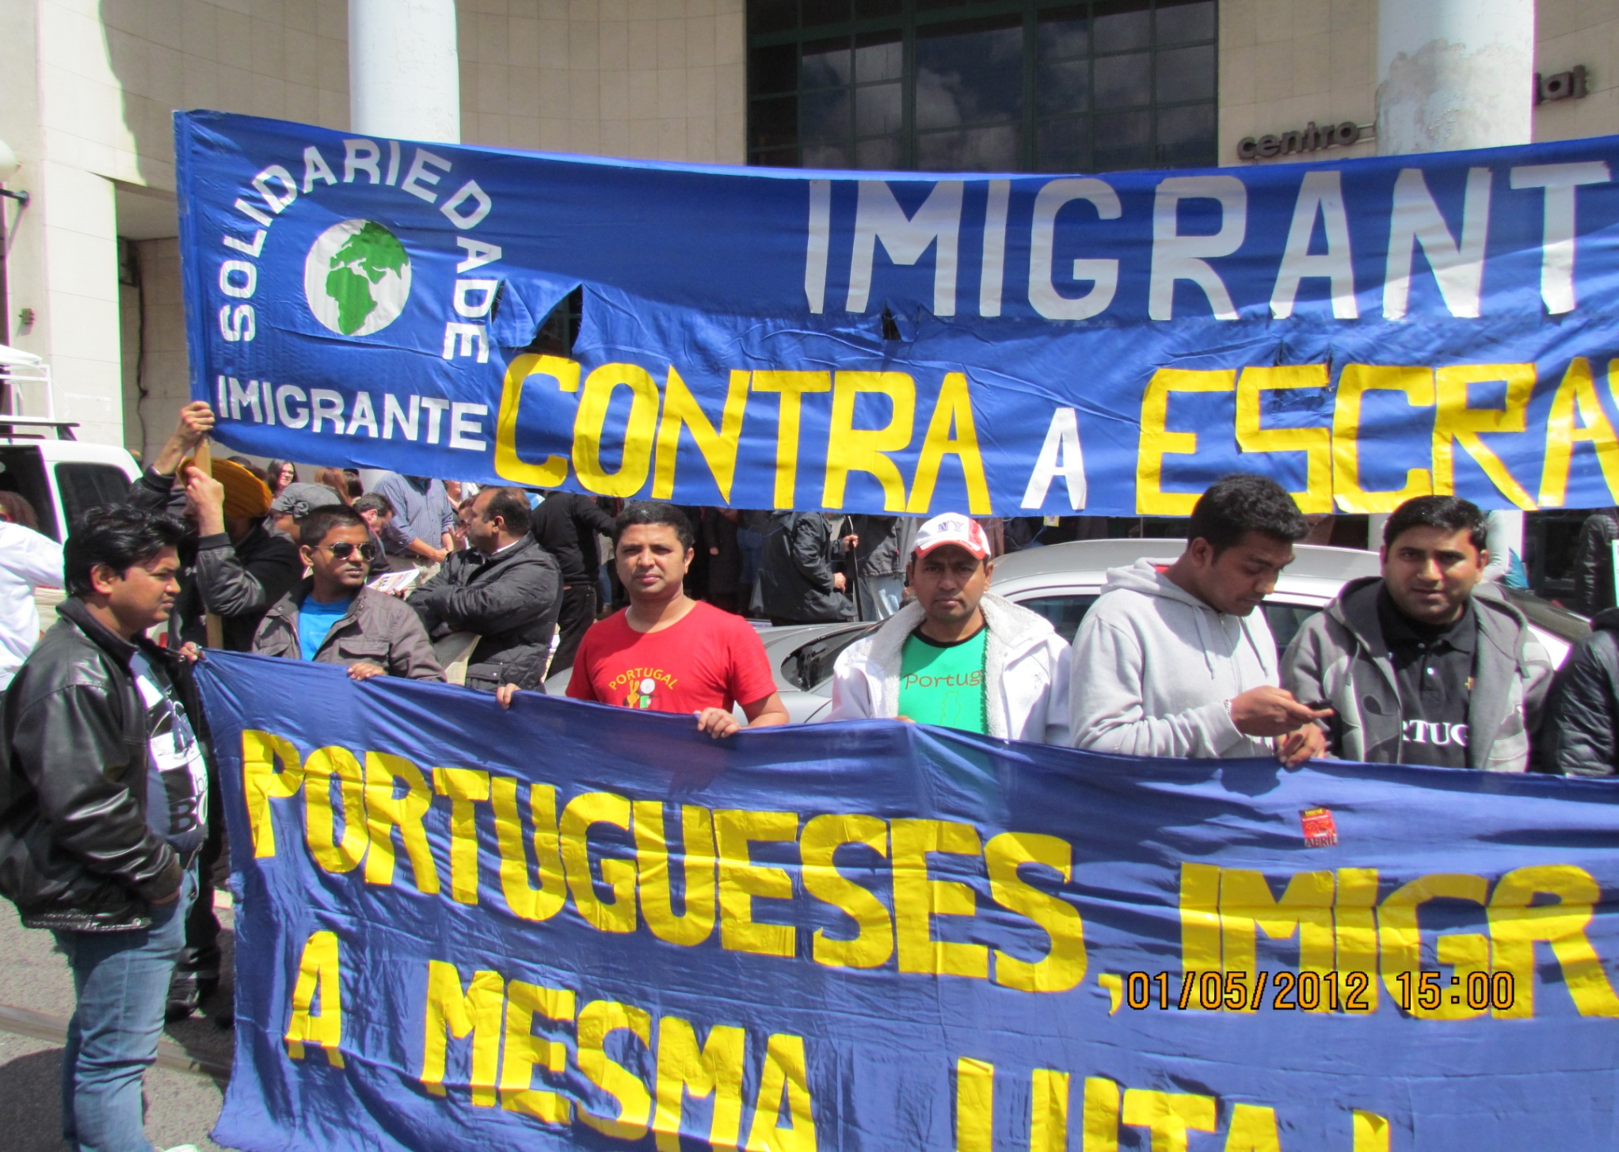

Slide 28
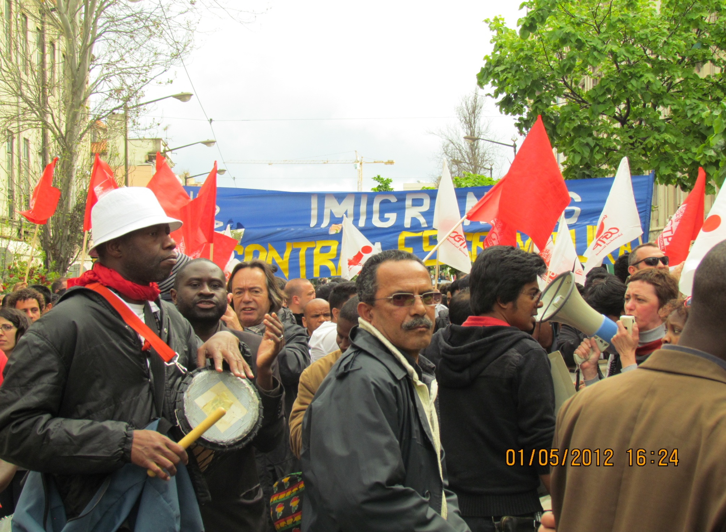

Slide 29
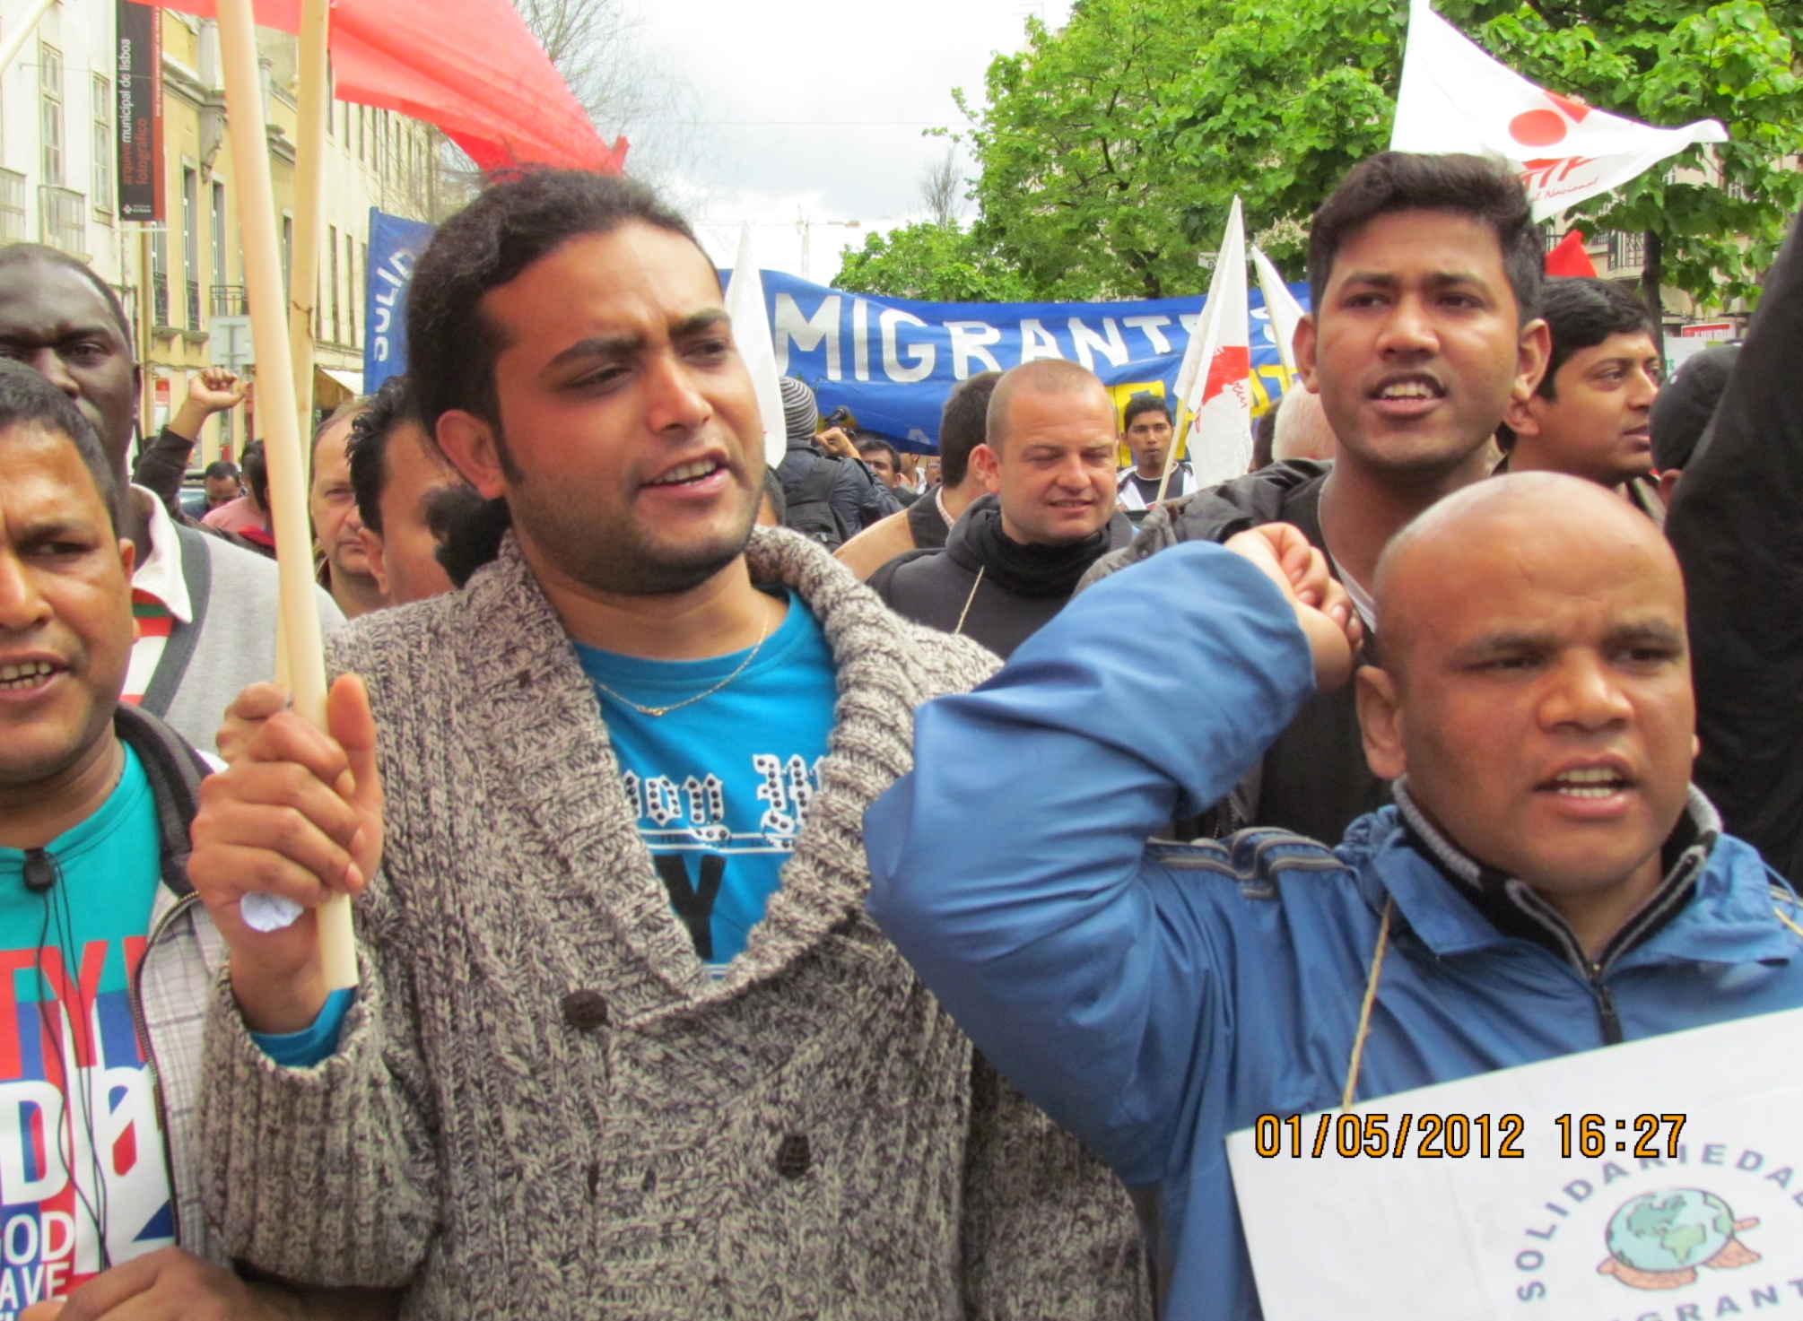

Slide 30
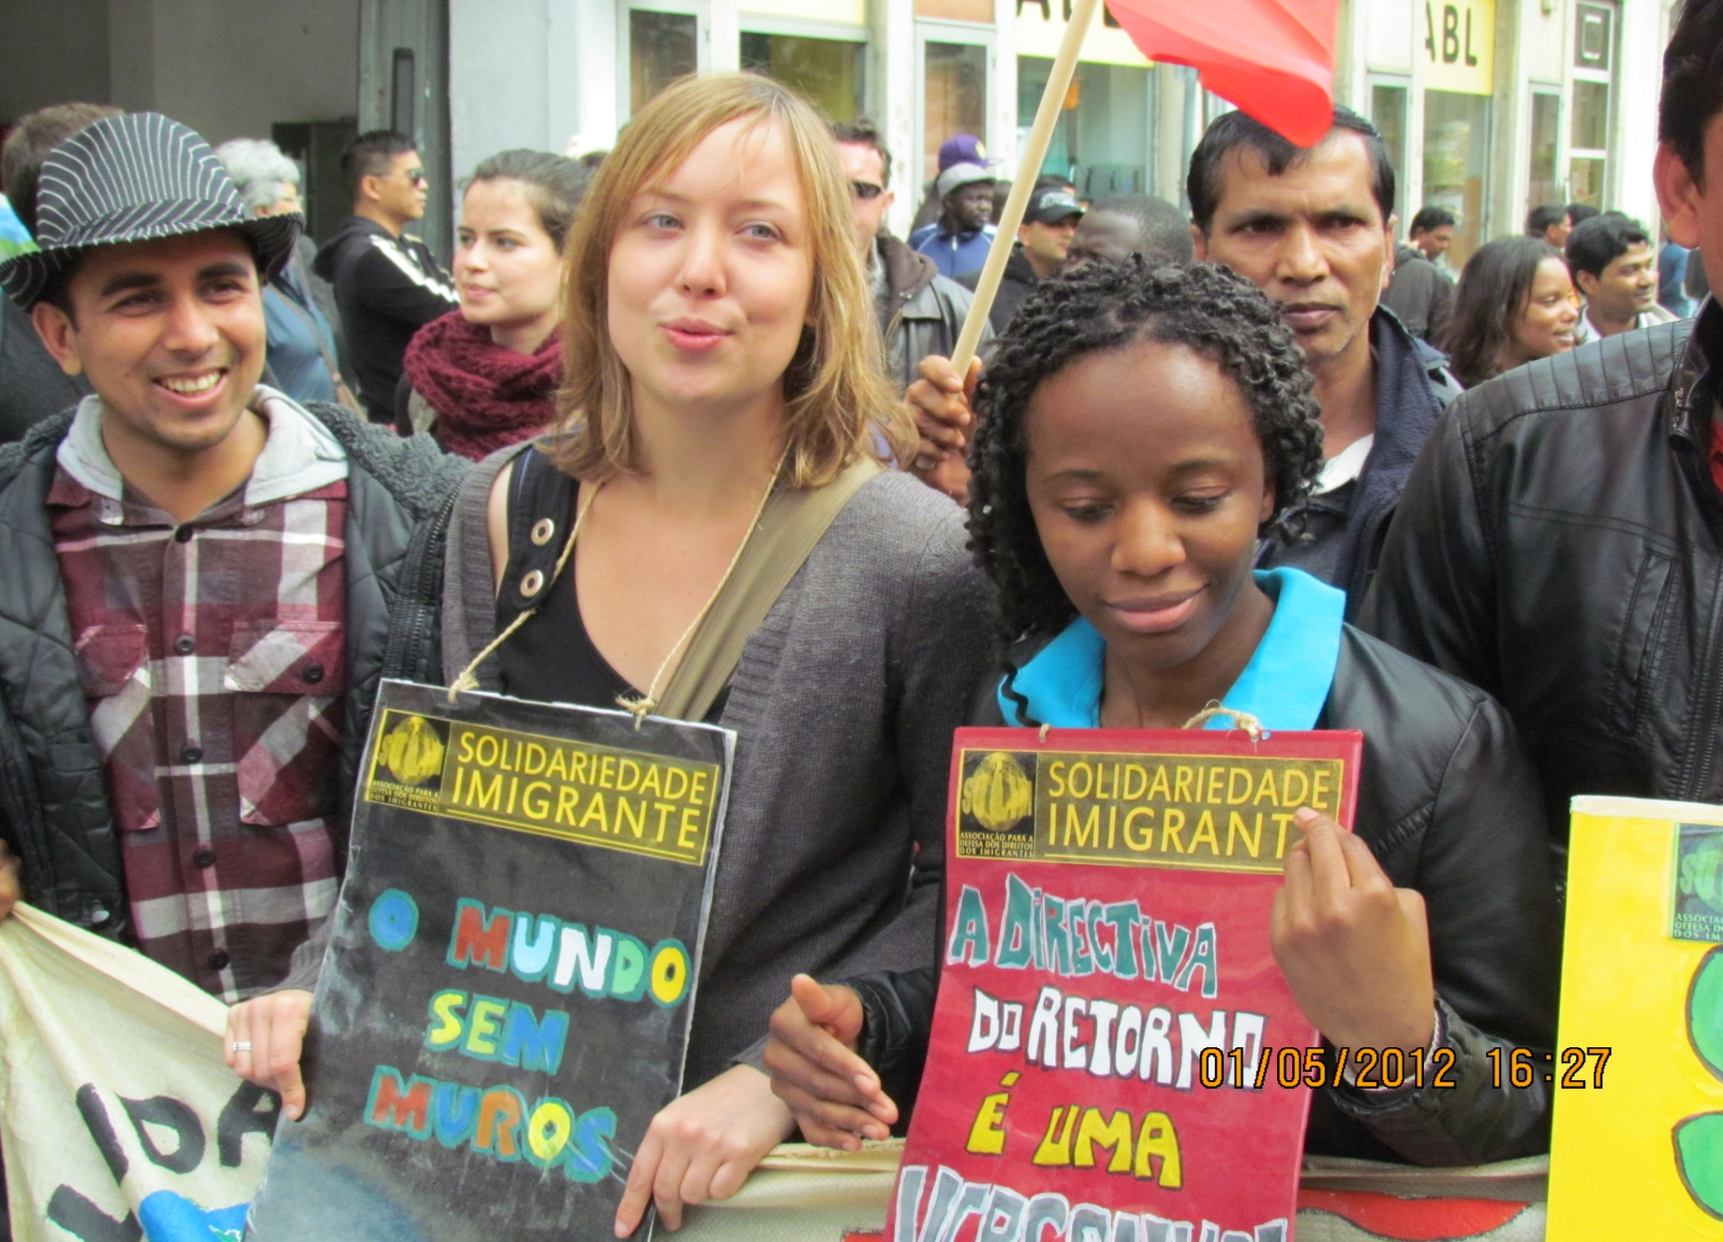

Slide 31
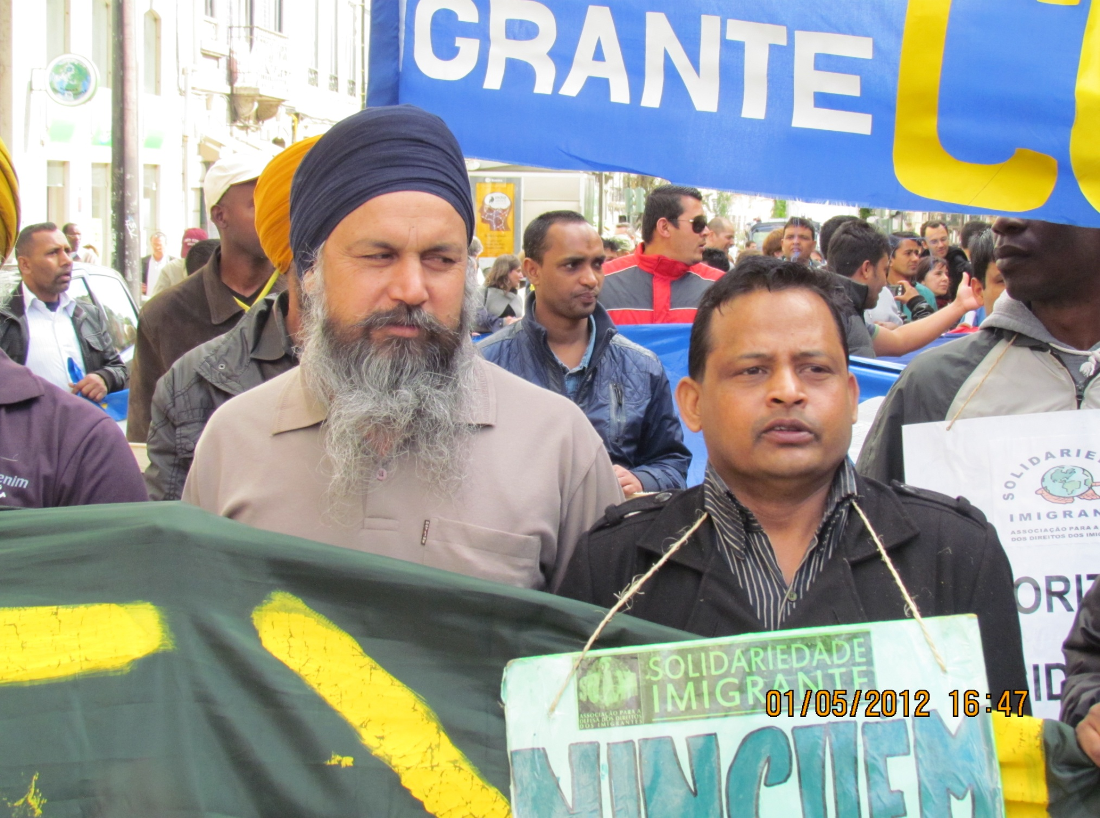

Slide 32
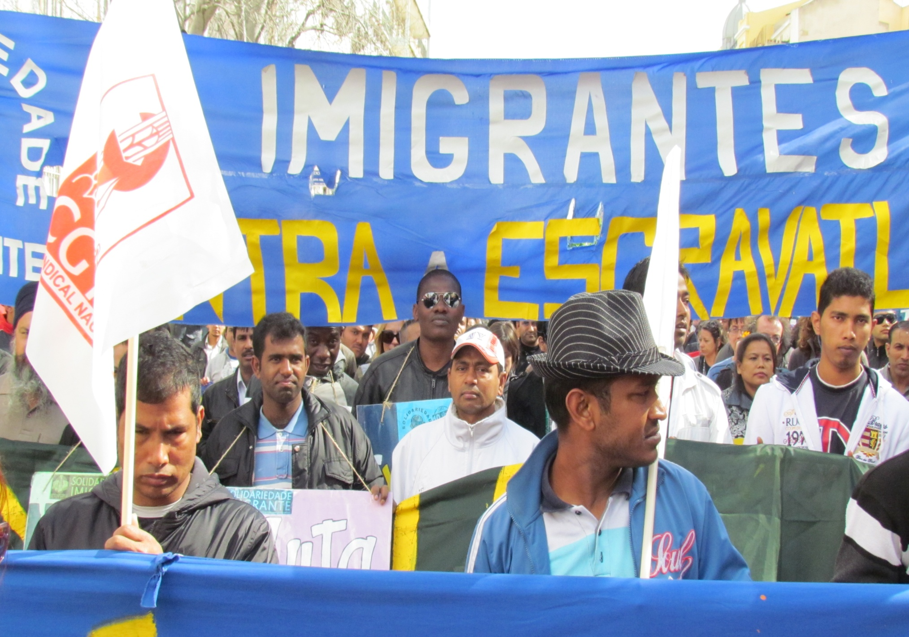

Slide 33
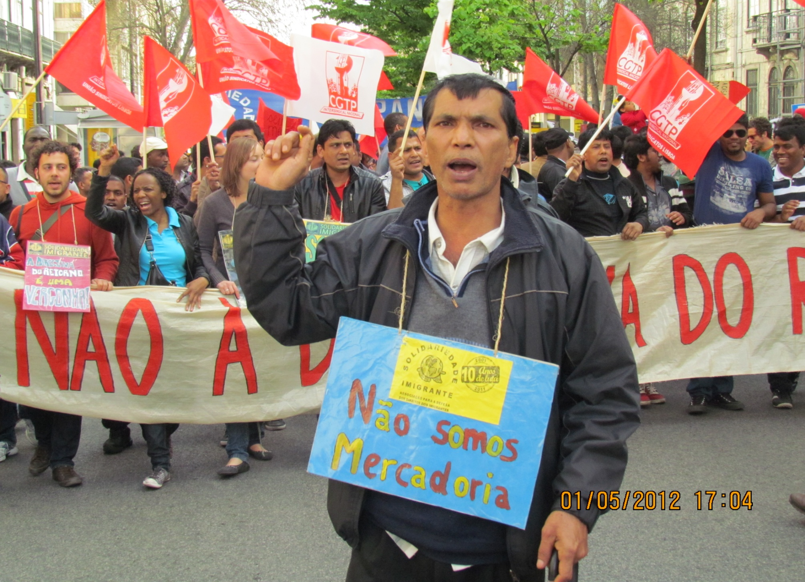

Slide 34
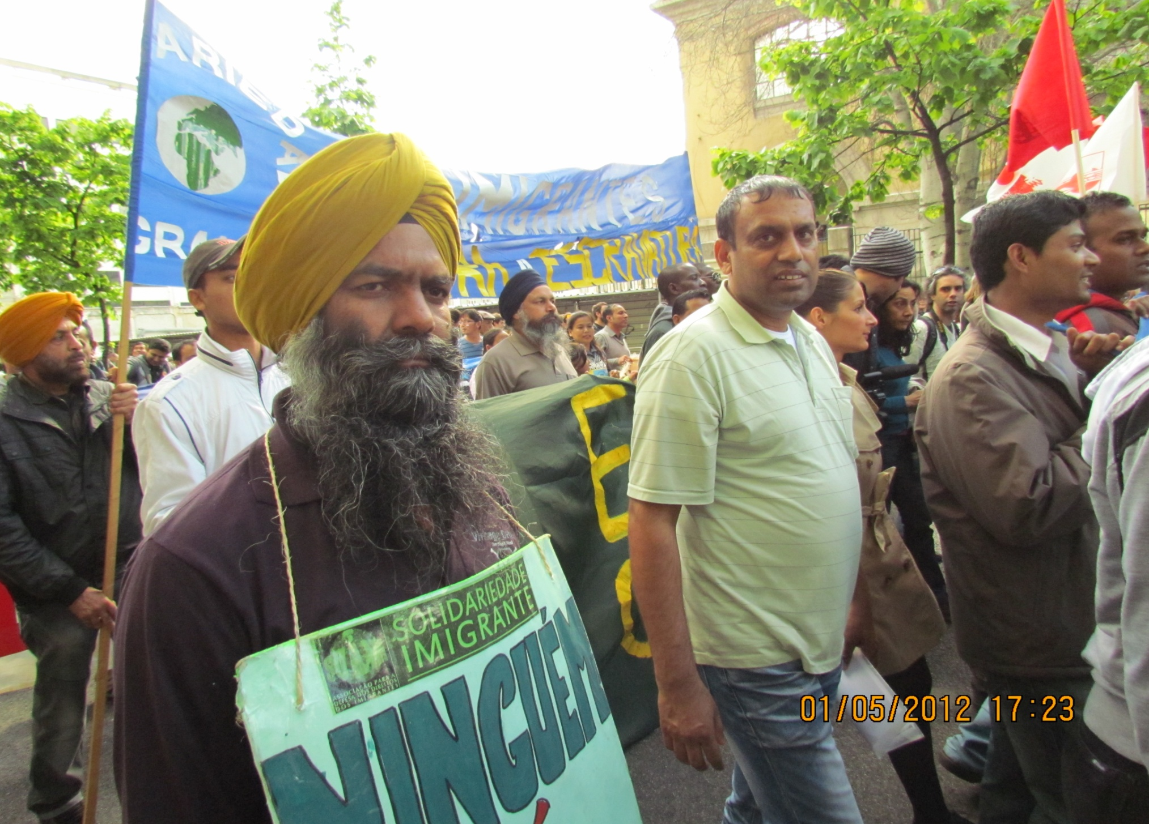

Slide 35
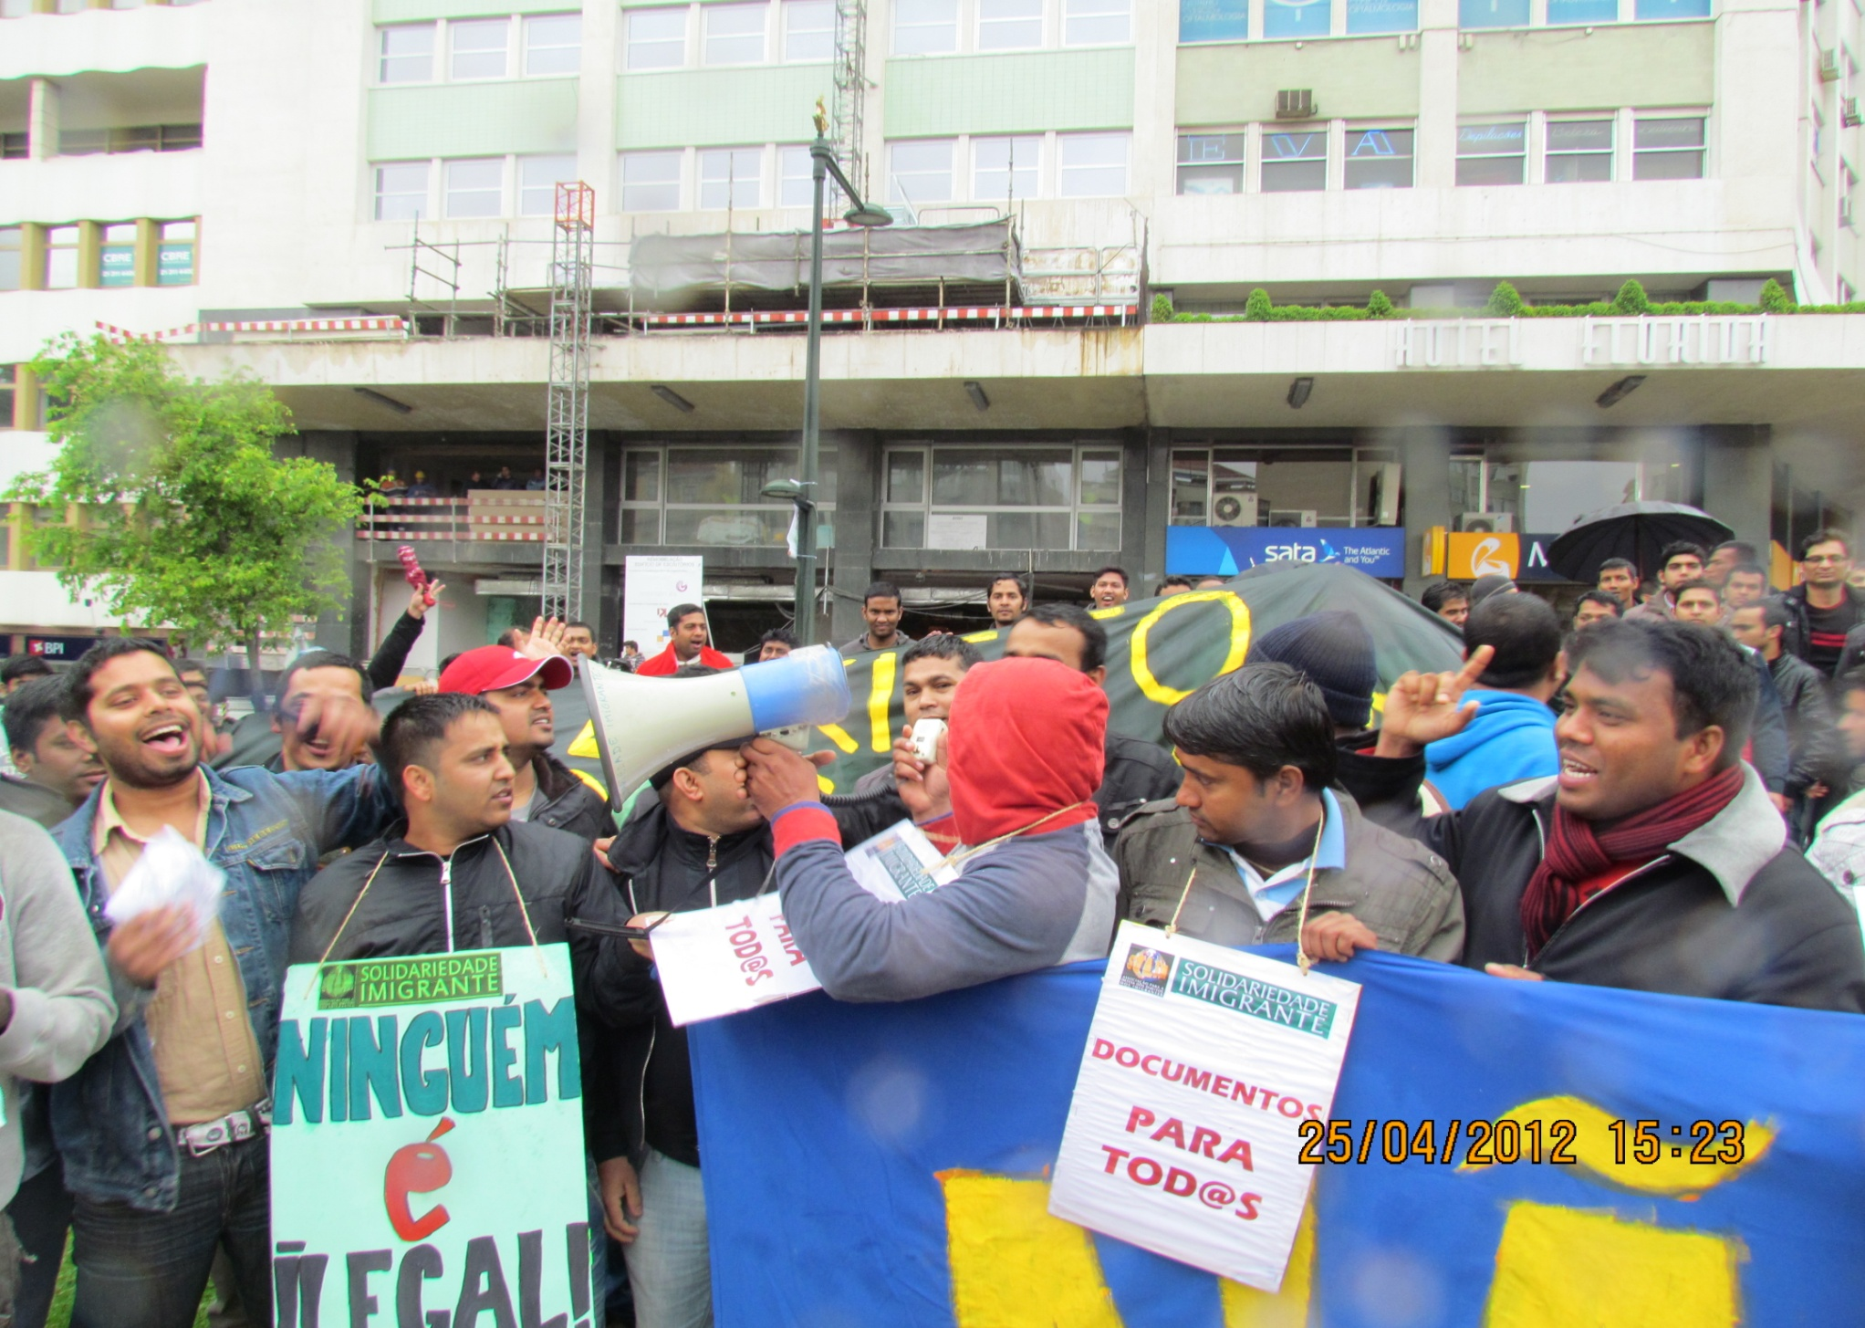

Slide 36
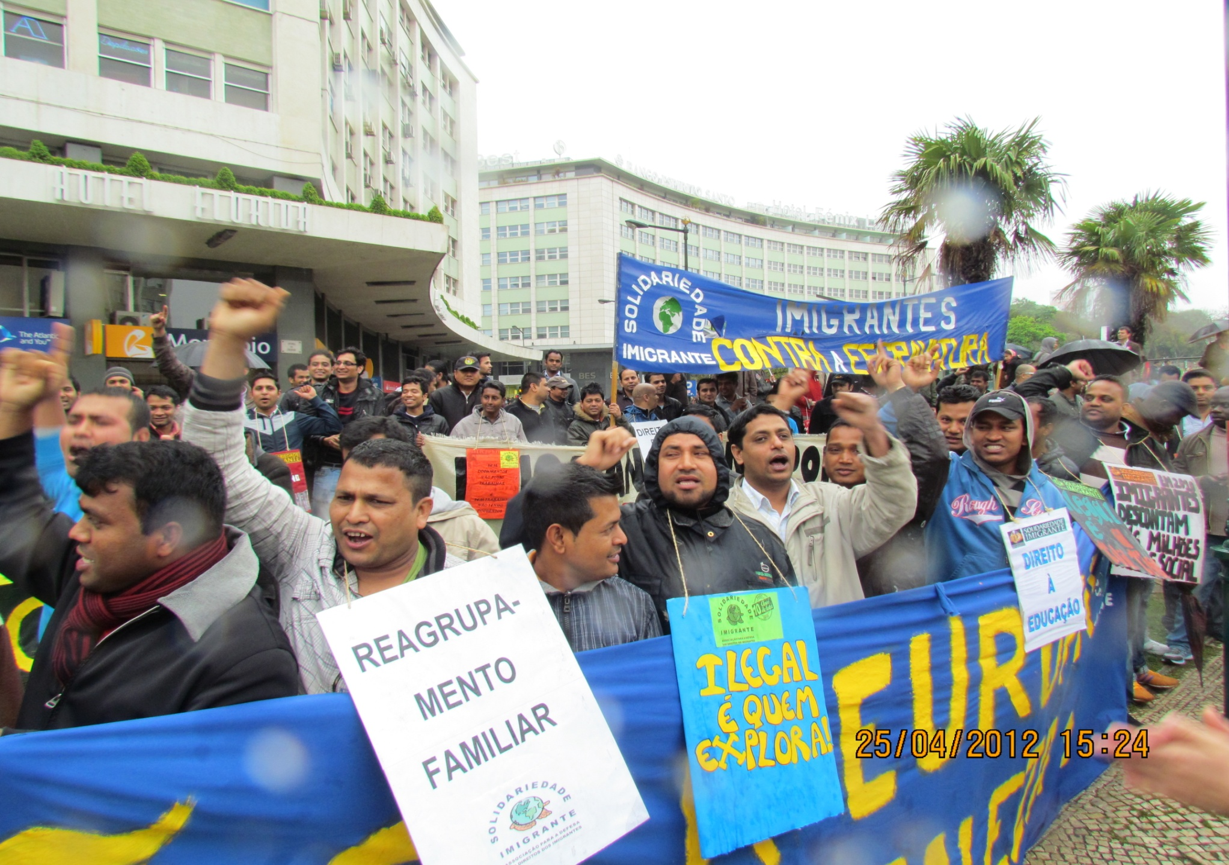

Slide 37
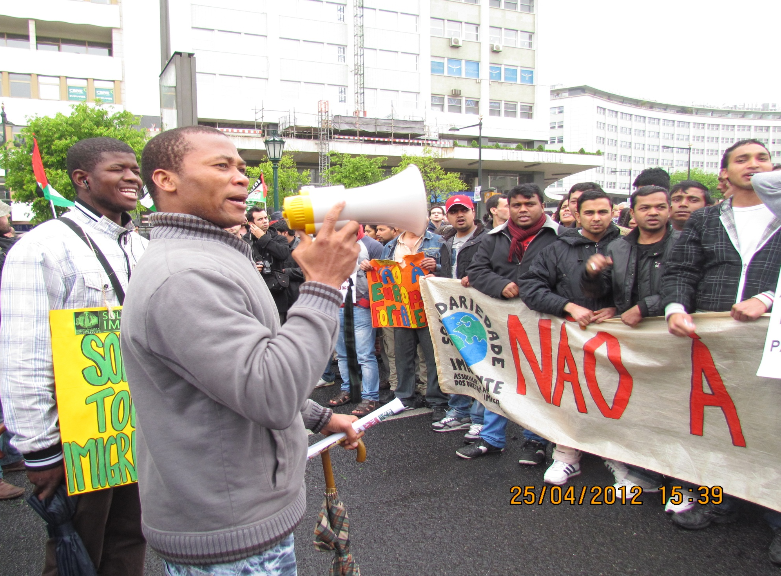

Slide 38
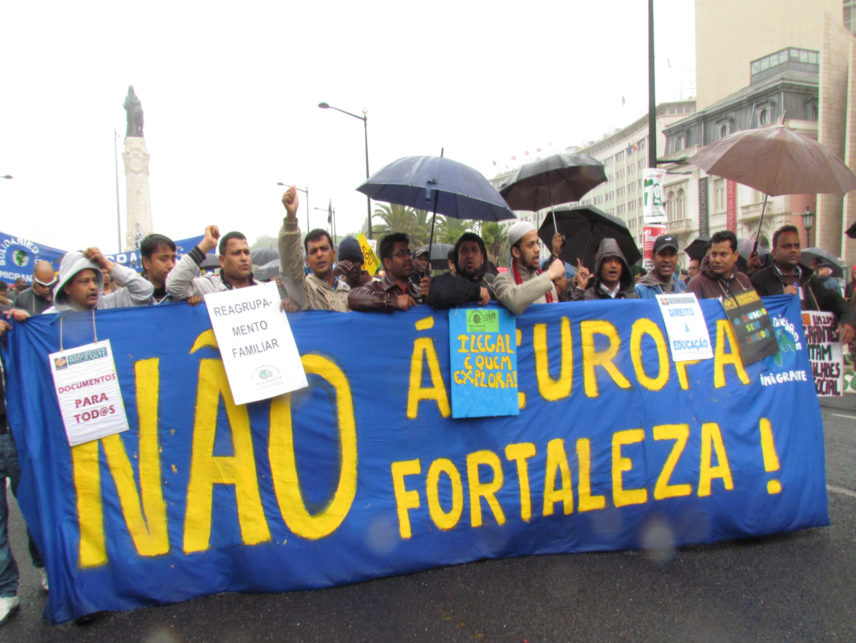

Slide 39
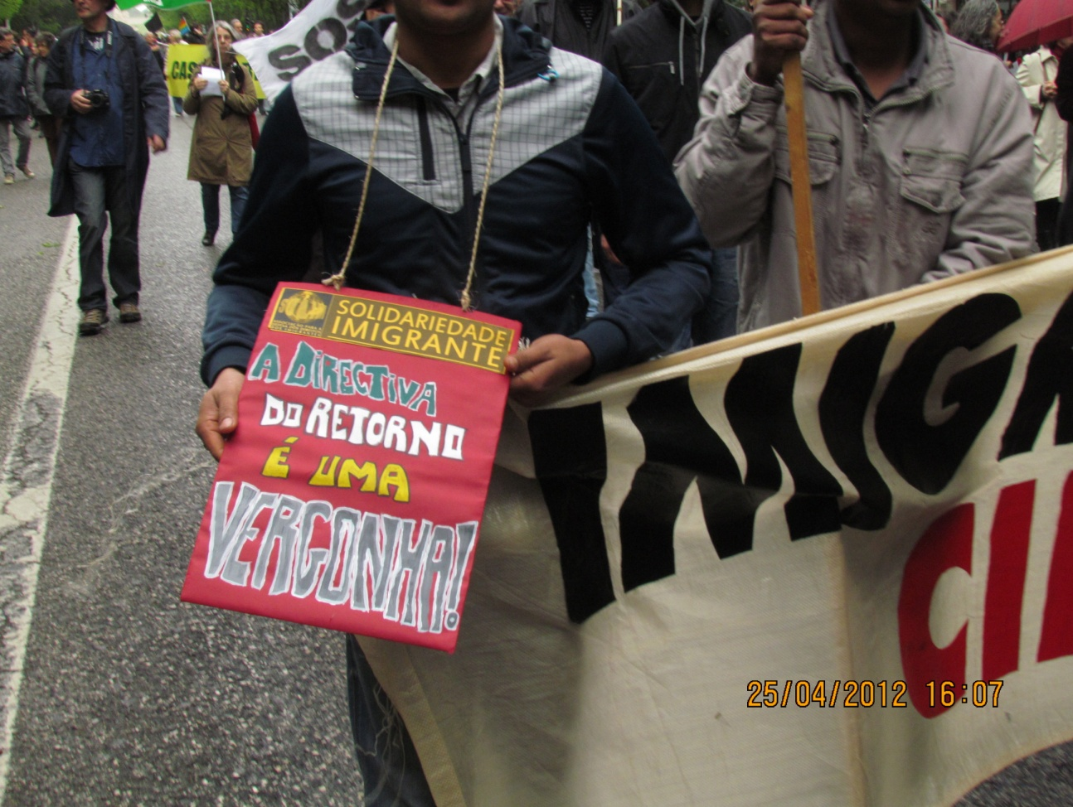
IMMIGRANT SOLIDARITY Association for the Defense of Immigrants' Rights
Nacional Headquarters:
Rua da Madalena n.º 8, 2º Andar
1100-321 Lisboa, Portugal
Telefone/Fax: (00351)218870713
www.solimigrante.org
solidariedade_imigrante@hotmail.com

